Slide 1
Introduction to Java for C++ Programmers
Introduction to Java and Understanding its Differences with C++

Slide 2
Goals of JAC444 (what will you learn?)
JAC444 tries to make you a better Java programmer by making you familiar with:
“Basic concepts in Java Programming” using “your previous experiences in programming” and by noting the “differences” in Java.
Emphasizing “how to develop good habits and skills to become better Java programmers”.
“Basic OO terminology and concepts in Java”: Abstraction, Encapsulation, Inheritance, Polymorphism, etc.
“Basic Functional Programming terminology and concepts in Java”: Functional Interfaces, Lambda Expressions, Method references, Streams, etc.
Some “advanced Java terminology and concepts”: Multi-threading, Networking, RMI, JDBC, etc.

Slide 3

Weekly Lectures and Labs
This course will not introduce you to OO concepts, therefore you must be proficient in OO concepts from C++ programming language. The recommended pre-requisite is the successful completion of OOP344.
Lectures are instructor-centred. Ask questions anytime during the lecture. There would also be after-lecture quizzes with bonus marks!
Silence your cell phones in class and be respectful of others.
Lab activities are there to solidify and to complement (or add to) the weekly lecture material. Lab activities are not marked, but try to do your best! Their solutions will be presented to you in labs.
Your best resource would be Oracle’s online Java tutorials at http://docs.oracle.com/javase/tutorial/

Slide 4

Assignments
You will have 3 assignments.
Each assignment should be submitted on its due date. The deduction for late submission will be 10% each day or part of it. No assignment will not be accepted after week 12.
All the assignments should be done satisfactorily to pass the course.
Students are encouraged to talk to each other, to the instructor, or to anyone else about any of the assignments, but the final solution may not be copied from any source. The assignments should be submitted online.

Slide 5
Tests
You will have 2 tests (midterms) and a final exam. Don’t miss the tests! They can’t be redone.
The midterms will be opened-book exams and the contents will cover all the material presented to that point in the class.
The final exam will also be an opened-book exam and its contents is based on the topics covered in the entire course.
The first test would be in week 7 and the second would be in week 12.

Slide 6

Graded Work
Content | %
Assignments (3) | 30%
Tests (2) | 40%
Final Exam | 30%
Total | 100%
Standards:
To obtain a credit in this subject, a student must:
Achieve a grade of 50% or better on the final exam
Satisfactorily complete all assignments
Achieve a weighted average of 50% or better for the tests and final exam
Achieve a grade of 50% or better on the overall course

Slide 7
Steps For Success …
Take “notes” on course material, including solutions to any problems that arise – The first step in learning.
“Follow” course concepts and come prepared to labs.
“Thoroughly read all steps” in the labs and assignments “before starting.”
Ask other students or teacher for help or insight if needed “during the lab.” Please don’t ask coding questions by emails; in lots of cases they are hard to answer remotely. Instead, arrange for an appointment during office hours.

Slide 8
Steps For Success … (Cont’d)
Attend all classes and “be on time.”
“Silence” audible devices.
Don’t work on the labs or assignments during the lecture! Focus on the task at hand – “don’t multitask.”
Review previous lecture notes to get prepared for the next lecture, “before class.”
Submit all graded work on time.

Slide 9
Steps For Success … (Cont’d)
Even if you know some of the material already, we are going to emphasize the “professional practice” of those concepts. So, “be patient and pay attention all the time.”
“Keep quiet” during the lecture and “don’t distract others.”
The ultimate goal is to get you ready for the job market. So, get in the habit of being “punctual and respectful of others.” Treat your professor as your boss/manager and treat your classmates as your colleagues.

Slide 10
Steps For Success … (Cont’d)
During the tests, looking at others papers and/or talking before everyone is done is considered as “cheating.”
Check your grades whenever released, and if you have any concerns about them, talk to your professor “no later than the following week.”
You are responsible to “continuously and regularly check and follow” your Seneca emails for this course. There might “always” be important messages!

Slide 11
Steps For Success … (Cont’d)
Based on the emails your professor receives, it might take some time for him/her to reply your email; “be patient!”
If you miss a class, your professor is not going to re-teach that to you (even during office hours). You are having “some responsibilities for your learning.”
Don’t rush on leaving the labs sooner; instead, “concentrate on studying the steps needed to be done and doing them right!” Also, there might be “some directions or explanations needed from your professor before doing the assignments”. Therefore, even if you have thought about them before, listen to your professor’s explanations and then, do and submit your assignments.

Slide 12
Steps For Success … (Cont’d)
Assignments are to be done “on-time, and through Blackboard.” You can’t email them or submit them after their deadlines. Also, “be careful of your Blackboard submissions and double check everything” before them.
You have the right to ask help from your instructor or other students or search the web to develop your solutions, but the “ultimate answers should be yours.”

Slide 13
A Brief Java History *
Audio/Visual Leaning:
https://www.lynda.com/Java-tutorials/history-Java/377484/421278-4.html

Slide 14
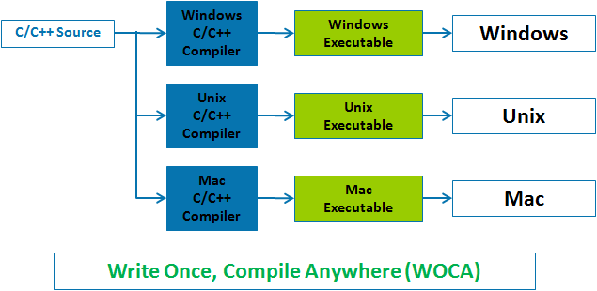
Some Differences with C++: Portability

Slide 15
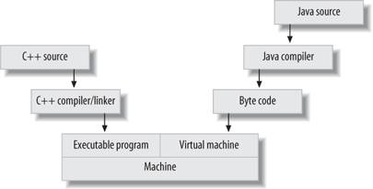
Some Differences with C++: Portability (Cont’d)

Slide 16
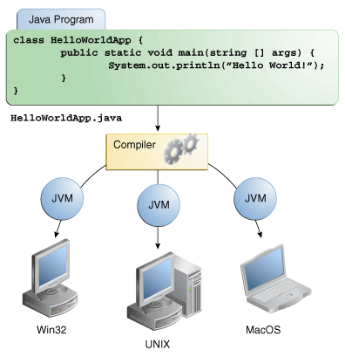
Some Differences with C++: Portability (Cont’d)

Slide 17
Some Differences with C++: Portability (Cont’d)
Being more high level and object oriented
Providing more convenience and security in programming, as in:
Using Local Variables (UsingLocalVarWithoutInit.cpp and UsingLocalVarWithoutInit.java)
Using Arrays (ArrayIndexOutOfBoundsInCPP.cpp and ArrayIndexOutOfBoundsInCPP.java)
Using Conditions (WhileTest.cpp and WhileTest.java)
Pointers, Multiple Inheritance, Operator Overloading, Dynamic Memory Management, etc.

Slide 18
Principles and components of Java *
Audio/Visual Leaning:
https://www.lynda.com/Java-tutorials/Principles-components-Java/377484/421279-4.html

Slide 19
Building blocks in a Java program and the Structure of a .java file
Packages (import), Classes (could be nested), and Methods (can’t be nested)
Structure of a .java file, and Naming conventions
Java syntax and compilation; Audio/Visual Leaning:
https://www.lynda.com/Java-tutorials/Java-syntax-compilation/377484/421280-4.html
Notes:
Java Naming Conventions:
Classes
Class names should be nouns in UpperCamelCase, with the first letter of every word capitalised. Use whole words — avoid acronyms and abbreviations (unless the abbreviation is much more widely used than the long form, such as URL or HTML).
EX: class Raster;
class ImageSprite;
Methods
Methods should be verbs in lowerCamelCase or a multi-word name that begins with a verb in lowercase; that is, with the first letter lowercase and the first letters of subsequent words in uppercase.
EX: run();
runFast();
getBackground();
Variables
Local variables, instance variables, and class variables are also written in lowerCamelCase. Variable names should not start with underscore (_) or dollar sign ($) characters, even though both are allowed. This is in contrast to other coding conventions that state that underscores should be used to prefix all instance variables.
Variable names should be short yet meaningful. The choice of a variable name should be mnemonic — that is, designed to indicate to the casual observer the intent of its use. One-character variable names should be avoided except for temporary "throwaway" variables. Common names for temporary variables are i, j, k, m, and n for integers; c, d, and e for characters.
EX: int i;
char c;
float myWidth;
Constants
Constants should be written in uppercase characters separated by underscores. Constant names may also contain digits if appropriate, but not as the first character.
EX: final int MAX_PARTICIPANTS = 10;

Slide 20
How to install JDK and Eclipse, Brief intro to Eclipse IDE, and Getting Started with Java *
Audio/Visual Leaning:
https://www.lynda.com/Java-tutorials/Installing-Java-Windows/377484/421284-4.html
(you could also use this file provided with the files of this week: Install-JavaSE-JDK-on-windows.pdf)
Eclipse: The IDE we use for the course (http://eclipse.org/downloads/)
Audio/Visual Leaning:
https://www.lynda.com/Java-tutorials/Hello-World/377484/421290-4.html
Writing your first Java program with/without using IDE (If you have problems compiling or running your program, please read this tutorial about potential solutions)
Notes:
Java Platform, Standard Edition (Java SE):
Java SE allows you to develop and deploy Java applications on desktops and servers. It contains the core of the Java programming language libraries.
The components of Java SE are Java Development Kit (JDK), Java Runtime Environment (JRE) and Java SE application programming interface (API).
JDK contains the JRE and the compilers and debuggers necessary for developing applications.
JRE provides the libraries, the Java Virtual Machine (JVM) and the components needed to run Java applications.
Java SE Conceptual Diagram
From: http://www.oracle.com/technetwork/topics/newtojava/documentation/index.html
A Java virtual machine (JVM) interprets compiled Java bytecode for a computer's processor so that it can perform a Java program's instructions identically, regardless of underlying CPU. The name of the application that implements a JVM in JavaSE is java.
Steps in developing java applications:
Step 1: Write your program using your preferred text editor
Step 2: Compile your program using javac compiler.
The result will be an file with the extension class This file contains bytecode. Bytecode is the compiled format for Java programs. Once a Java program has been converted to bytecode, it can be transferred across a network and executed by Java Virtual Machine (JVM). Bytecode files generally have a .class extension. (http://www.webopedia.com/TERM/B/bytecode.html)
Step 3: Run your program by using the java
A Java virtual machine (JVM) interprets compiled Java binary code (called bytecode) for a computer's processor (or "hardware platform") so that it can perform a Java program's instructions.
Overview of a Java virtual machine (JVM) architecture:
Source code is compiled to Java bytecode, which is verified, interpreted or JIT-compiled for the native architecture. The Java APIs and JVM together make up the Java Runtime Environment (JRE).
(http://en.wikipedia.org/wiki/Java_virtual_machine)
If you want to run a Java program and still have questions, check this:
http://docs.oracle.com/javase/tutorial/getStarted/intro/definition.html

Slide 21
JRE and JDK
Select all statements that are true about JDK (Java Development Kit) and JRE (Java Runtime Environment):
Each JDK contains one (or more) JRE’s along with the various development tools like the Java compiler, deployment tools, debuggers, development libraries, etc.
JDK does not contain JRE.
The JDK is a bundle of software that one can use to develop Java based software.
The JRE includes the JVM (Java Virtual Machine), which is what actually interprets the byte code and runs your program, but JDK does not include JVM.
Notes:
Ans. 1 and 3
When one needs only to run Java on a system, JRE (Java Runtime Environment) must be install. It contains JVM (the java interpreter) that runs Java programs and core packages.
When one needs only to develope Java software, JDK (Java Development Kit) must be installed JDK is called now Java SE (Java Standard Edition). JDK contains JRE because it needs to run Java program. So, JDK (Java SE) includes JRE that includes JVM.

Slide 22
Main Method
JAVA PROGRAM ENTRY POINT
Would the following program compile? If yes, does it run?
public class Question {
public static void main(String args) {
System.out.println("Can I see this?");
}
}
Notes:
Ans. The signature of the main method in java is: public static void main(String[])
The main method is sintactically defined correctly, but it is not recognized by JVM as entry point; it does not run.
Therefore JVM error is:
Main method not found in class Question, please define the main method as: public static void main(String[] args)

Slide 23
Overview of Primitive data types in Java
byte short int long | 8-bit two's complement 16-bit two's complement 32-bit two's complement 64-bit two's complement
float double | 32-bit IEEE 754 floating point 64-bit IEEE 754 floating point
char | 16-bit Unicode character
Check WrongBoolean.java
Notes:
Java Bytecode and the main features of the java programming language:
Architecture Neutral
The solution that the Java system adopts to solve the binary-distribution problem is a "binary code format" that's independent of hardware architectures, operating system interfaces, and window systems. The format of this system-independent binary code is architecture neutral. If the Java run-time platform is made available for a given hardware and software environment, an application written in Java can then execute in that environment without the need to perform any special porting work for that application.
The Java compiler doesn't generate "machine code" in the sense of native hardware instructions--rather, it generates bytecodes: a high-level, machine-independent code for a hypothetical machine that is implemented by the Java interpreter and run-time system.
The primary benefit of the interpreted byte code approach is that compiled Java language programs are portable to any system on which the Java interpreter and run-time system have been implemented.
The architecture-neutral aspect discussed above is one major step towards being portable, but there's more to it than that. C and C++ both suffer from the defect of designating many fundamental data types as "implementation dependent". Programmers labor to ensure that programs are portable across architectures by programming to a lowest common denominator.
Java eliminates this issue by defining standard behavior that will apply to the data types across all platforms. Java specifies the sizes of all its primitive data types and the behavior of arithmetic on them.
The data types and sizes described above are standard across all implementations of Java. These choices are reasonable given current microprocessor architectures because essentially all central processor architectures in use today share these characteristics. That is, most modern processors can support two's-complement arithmetic in 8-bit to 64-bit integer formats, and most modern processors support single- and double-precision floating point.
Copyright © 1997 Sun Microsystems, Inc. All Rights Reserved.
Primitive Data Types
Other than the primitive data types discussed here, everything in the Java programming language is an object. Even the primitive data types can be encapsulated inside library-supplied objects if required. The Java programming language follows C and C++ fairly closely in its set of basic data types, with a couple of minor exceptions. There are only three groups of primitive data types, namely,numeric types, character types, and Boolean types.
Numeric Data Types
Integer numeric types are 8-bit byte, 16-bit short, 32-bit int, and 64-bit long. The 8-bit byte data type in Java has replaced the old C and C++ char data type. Java places a different interpretation on the char data type, as discussed below.
There is no unsigned type specifier for integer data types in Java.
Real numeric types are 32-bit float and 64-bit double. Real numeric types and their arithmetic operations are as defined by the IEEE 754 specification. A floating point literal value, like 23.79, is considered double by default; you must explicitly cast it to float if you wish to assign it to a float variable.
Character Data Types
Java language character data is a departure from traditional C. Java's char data type defines a sixteen-bit Unicode character. Unicode characters are unsigned 16-bit values that define character codes in the range 0 through 65,535. If you write a declaration such as
char myChar = `Q'; you get a Unicode (16-bit unsigned value) type initialized to the Unicode value of the character Q. By adopting the Unicode character set standard for its character data type, Java language applications are amenable to internationalization and localization, greatly expanding the market for world-wide applications.
Boolean Data Types
Java added a Boolean data type as a primitive type, tacitly ratifying existing C and C++ programming practice, where developers define keywords for TRUE and FALSE or YES and NO or similar constructs. A Java boolean variable assumes the value true or false. A Java programming language boolean is a distinct data type; unlike common C practice, a Java programming language boolean type can't be converted to any numeric type.
Copyright © 1997 Sun Microsystems, Inc. All Rights Reserved.

Slide 24
Overview of Primitive data types in Java (Cont’d)
Java has build-in primitives to support boolean, character, integer and
floating-point values.
-----------------------------------------------------------------------------------------
boolean either true or false boolean b = true;
------------------------------------------------------------------------------------------
char 16-bit Unicode 1.1 character char ch = ‘J’;
------------------------------------------------------------------------------------------
byte 8-bit integer (signed) byte bt = 127;
short 16-bit integer (signed) short sh = 32767;
int 32-bit integer (signed) int i = 2147483647;
long 64-bit integer (signed) long l = 9223372036854775807L;
-------------------------------------------------------------------------------------------
float 32-bit floating-point (IEEE 754-1985) float f = 1.0f;
double 64-bit floating-point (IEEE 754-1985) double d = 1.e-1;
-------------------------------------------------------------------------------------------

Slide 25
Overview of Primitive data types in Java (Cont’d)
BYTE RANGE VALUES
What is the range of a byte value in Java?
0..255
It depends on compiler
-128..127
It depends on 32/64 Operating System.
Notes:
Ans. In Java integers are signed represented in two's complement system, where first bit function as a sign indicator. Since 2^8=256, we have 128 negative numbers, 127 positive numbers, plus zero

Slide 26
Overview of Primitive data types in Java (Cont’d)
TWO'S COMPLEMENT
If the two's complement value of a byte x is 11111011, What is the value of x?
5
-7
-5
7
Notes:
Ans. -5
For example, using 1 byte (= 2 nibbles = 8 bits), the decimal number 5 is represented by
0000 0101
The most significant bit is 0, so the pattern represents a non-negative value. To convert to −5 in two's-complement notation, the bits are inverted; 0 becomes 1, and 1 becomes 0:
1111 1010
At this point, the numeral is the ones' complement of the decimal value −5. To obtain the two's complement, 1 is added to the result, giving:
1111 1011
The result is a signed binary number representing the decimal value −5 in two's-complement form. The most significant bit is 1, so the value represented is negative.
The two's complement of a negative number is the corresponding positive value. For example, inverting the bits of −5 (above) gives:
0000 0100
And adding one gives the final value:
0000 0101
http://en.wikipedia.org/wiki/Two%27s_complement#Converting_to_two.27s_complement_representation

Slide 27
Overview of Primitive data types in Java (Cont’d)
Char DEFAULT VALUE
What is the default value of a char?
Empty
it depends on memory location
\u0000
\x0000
Notes:
Ans. Unicolde value of 0 is \u0000

Slide 28
Overview of Primitive data types in Java (Cont’d)
UNICODE
What is Unicode? Select the answer that matches:
An international encoding standard for use with different languages
It uses 7 bits for each character
It uses 16 bits, which means that it can represent more than 65,000 unique characters
Notes:
Ans. 1 and 3

Slide 29
Overview of Primitive data types in Java (Cont’d)
Char DECLARATION
How could one declare and initialize a variable of type char in Java?
char c1 = 'java';
char c2 = \u0123;
char c3 = 01230;
char c4 = '\ibafe';
char c5 = '\ubafe';
char c6 = 0xbafe;
Notes:
Ans. 3, 5, 6
c1 = 'java'; wrong string
c2 = \u0123; wrong missing '
c3 = 01230; correct octal value
c4 = '\ibafe'; wrong \i
c5 = '\ubafe'; correct unicode representation
c6 = 0xbafe; correct hexadecimal representation

Slide 30
Overview of Operators in Java
All the familiar C and C++ operators apply in Java.
The Java programming language has no unsigned data types, so the >>> operator has been added to the language to indicate an unsigned (logical) right shift.
Java also uses the + operator for string concatenation; concatenation will be covered later, in the discussion on strings.

Slide 31
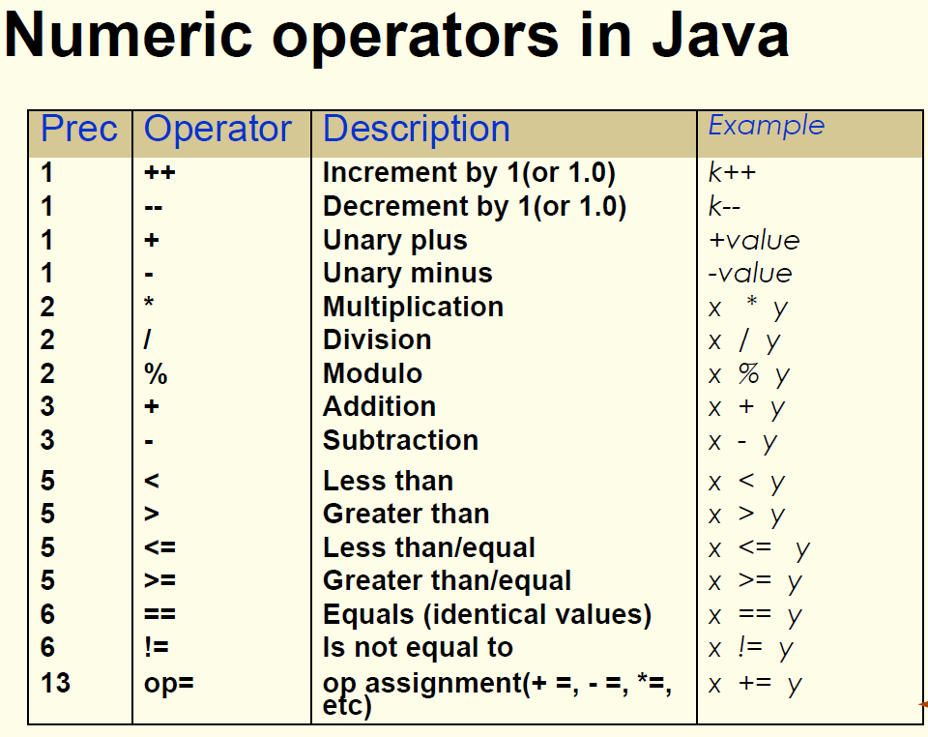
Overview of Operators in Java (Cont’d)

Slide 32
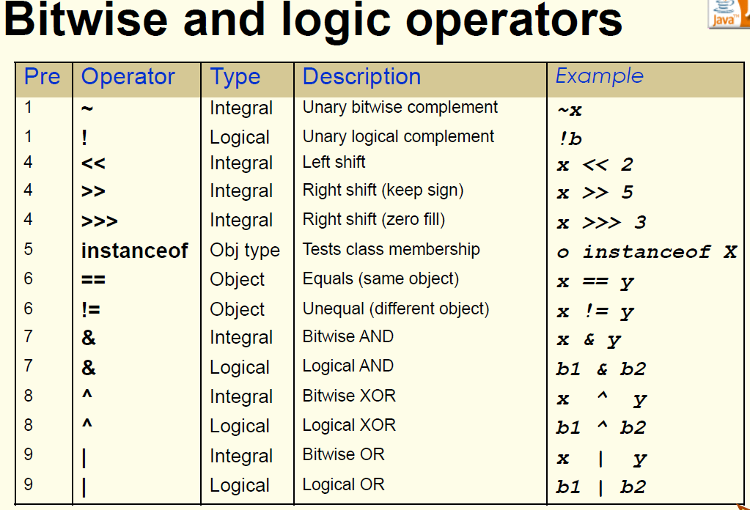
Overview of Operators in Java (Cont’d)

Slide 33
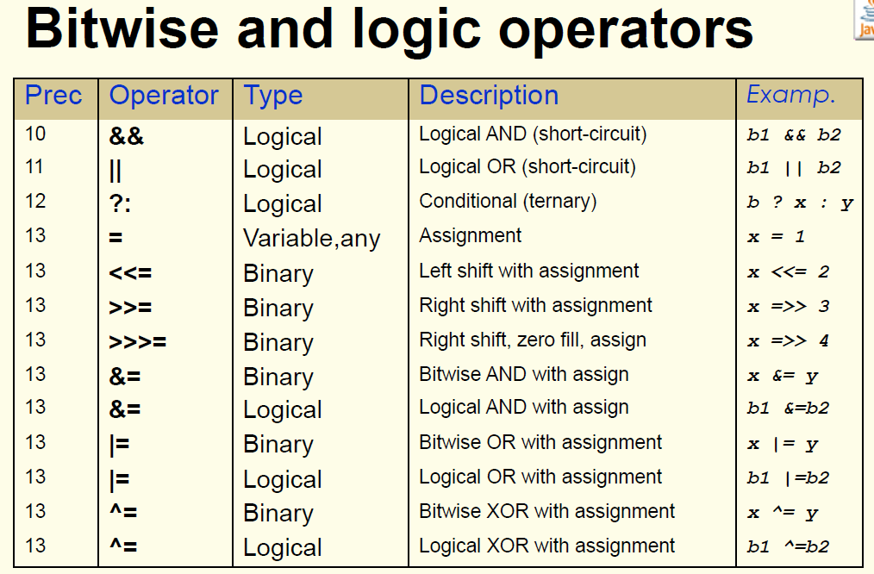
Overview of Operators in Java (Cont’d)

Slide 34
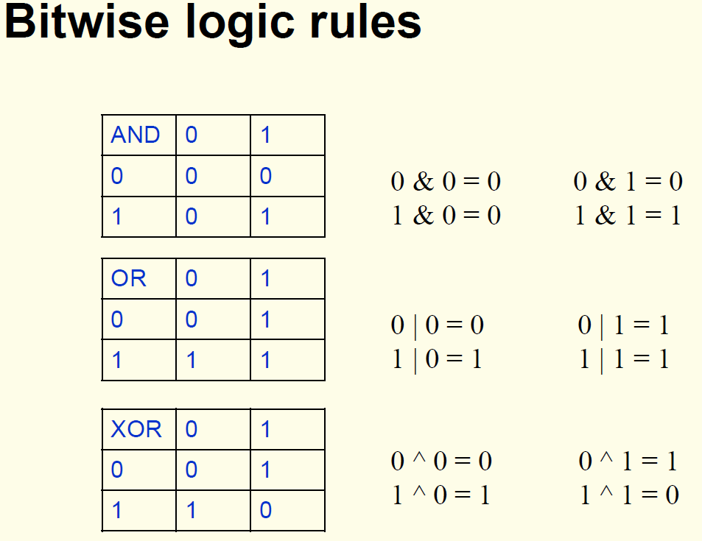
Overview of Operators in Java (Cont’d)

Slide 35
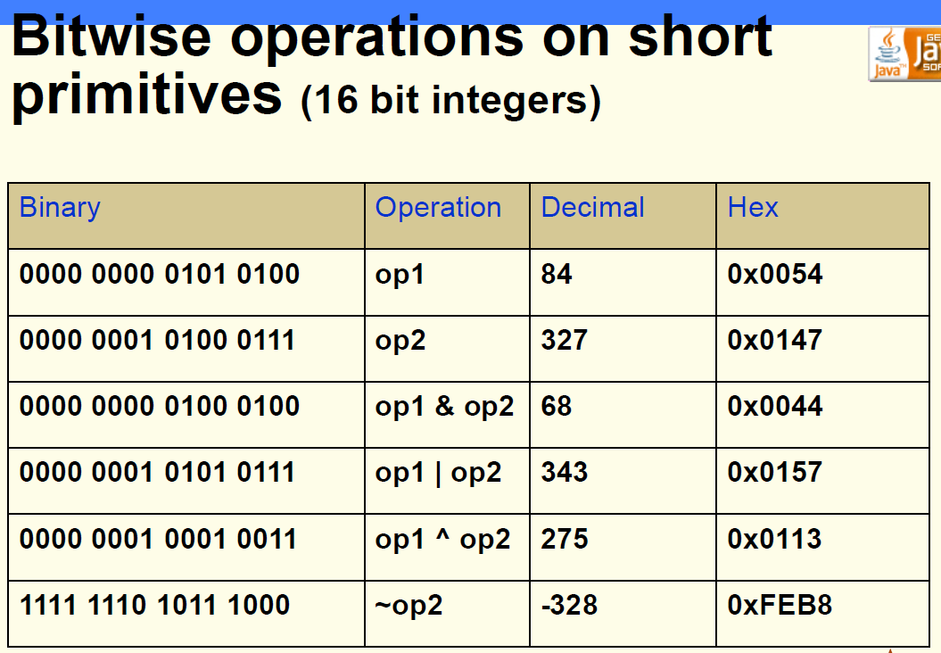
Overview of Operators in Java (Cont’d)

Slide 36
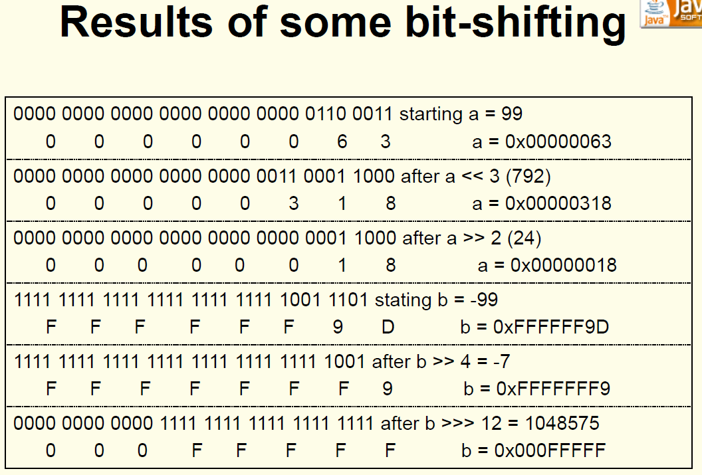
Overview of Operators in Java (Cont’d)

Slide 37
Overview of Operators in Java (Cont’d)
TERNARY OPERATOR
Given the expression a = x ? b : c; which statements are true?
1- The types of the expressions b and c must be compatible and are made identical through conversion
2- The type of the expression x must be boolean.
3- The type of the expressions b and c must be assignment compatible with the type of a.
4- The value assigned to a will be b if x is true or will be c if x is false.
Notes:
Ans. All the 4

Slide 38
Overview of Operators in Java (Cont’d)
TERNARY NESTED OPERATOR
Given the Java code
byte b = 127;
b = (b < 127) ? b > -128 ? b = 1 : 2 : 3;
System.out.println(b);
What will it be printed?
1
2
3
Does not compile
Notes:
Ans. 3
The code compiles. Since b = 127 if one writes the code b = (b < 127) ? (b > -128 ? b = 1 : 2) : 3; the second part of (b < 127) ? is executed. Therefore b = 3

Slide 39
Overview of Operators in Java (Cont’d)
TERNARY OPERATOR
Given the Java code
byte x = ?;
boolean b = x == (x > ~x ? x : ~x);
What values should take x, such as boolean b to be true?
x >= 0
x < 0
does not compile
Notes:
Ans. x >=0
The unary bitwise complement ~ change the number sign. For every x >=0 ~x is a negative number x > ~x ? x : ~x is always x.

Slide 40
Overview of Operators in Java (Cont’d)
BITWISE OPERATIONS
If x and y are two variables of type byte such as:
byte x = 5;
byte y = 7;
Enter the numerical value of x & y:
Enter the numerical value of x | y:
Enter the numerical value of x ^ y:
Notes:
Ans.
5
7
2

Slide 41
Overview of Operators in Java (Cont’d)
SHIFT OPERATOR
If we have:
int x = 444;
Enter the value of x >> 1:
Enter the value of x << 1:
Notes:
Ans.
222
888
Right shift operator, >>, divides the value by 2
Left shift operator, <<, multiplies the value by 2

Slide 42
Overview of Operators in Java (Cont’d)
ARITHMETIC
Given the following Java method:
public int adder(int n) {
return 0x100 + n++;
}
Enter the value of adder(2):
Enter the value of adder(010):
Enter the value of adder(0xA):
Notes:
Ans.
0x100 = 256 + 2 = 258
010 = 8 in octal, 256 + 8 = 264
0xA = 10 in hex, 256 + 10 = 266

Slide 43
Overview of Operators in Java (Cont’d)
SIMPLE PROGRAM
After your run this program, what is the value of variable i:
class What {
public static void main(String[] args) {
int i = 1;
if (i == 1)
i = i + 1;
System.out.println(i);
}
}
Notes:
Ans. 2
As the initial value of i is 1 the test will result in increasing its value by 1. So i = 2 at the end of this program

Slide 44
Type Conversions
Java is a strongly-typed language.
Implicit conversion for primitive value: any numeric value can be assigned to any numeric variable whose type supports a larger range of values.
byte → short → int → long → float → double
Explicit conversion or casting:
boolean type doesn’t allow any casting at all.
A char can be cast to any integer type and vice versa except to a short type. When char type is cast to int type, upper bits are filled with zeros.
Attention: integer types are converted by chopping off the upper bits. If the larger integer has a value outside the range off the smaller type, dropping the upper bits changes the value, including possibly changing sign.
Ex: short x = -129;
byte y = (byte)x; What is the value of y ???
Notes:
Ans. 127

Slide 45
Type Conversions (Cont’d)
BYTE CONVERSION 1
Given the following Java statements
byte b = 1;
b = ++b + 1;
System.out.println(b);
What do you obtain, if you try to compile and run this code?
2
3
Or …?
Notes:
Ans. Compile error: cannot convert from int to byte
Since the value 1 is of type int, the expression ++b + 1 has an integer type, therefore cannot be assigned to b, which is a variable of type byte

Slide 46
Type Conversions (Cont’d)
BYTE CONVERSION 2
Given the following Java statements
byte b = 1;
b += ++b + 1;
System.out.println(b);
What do you obtain, if you try to compile and run this code?
2
3
4
Or …?
Notes:
Ans. 4
Add AND assignment operator +=
It adds right operand to the left operand and assign the result to left operand
b += 1 is an equivalent to b = (byte)(b + 1)
A compound assignment expression of the form E1 op= E2 is equivalent to E1 = (T)((E1) op (E2)), where T is the type of E1, except that E1 is evaluated only once.
b = b + 1 does NOT compile, but b += 1 complies since it is changed to b = (byte)(b + 1)

Slide 47
Type Conversions (Cont’d)
FLOAT CONVERSION 1
Given the following Java statements
float f = 1;
f += 1.0;
What do you obtain, if you try to compile and run this code?
1.0
2.0
Or …?
Notes:
Ans. float f = 1; is compiled properly, since 1 is converted to float. Furthermore f += 1.0 is changed to f = (float) (f + 1.0) and it is compiled properly.
So the answer is 2.0

Slide 48
Type Conversions (Cont’d)
FLOAT CONVERSION 2
Given the following Java statements
float f = 1.0;
f += 1.0;
What do you obtain, if you try to compile and run this code?
1.0
2.0
Or …?
Notes:
Ans. Compile error: cannot convert from float to double
Since 1.0 is of type double and variable f is of type float, the statement float f = 1.0; does NOT compile

Slide 49
BOOLEAN EXPRESSIONS
What operators either change the value of a boolean expression or combine two boolean expressions?
Arithmetic operators
Ternary operators
Boolean operators
Relational operators
Notes:
Ans. Boolean operators
| the OR operator & the AND operator ^ the XOR operator ! the NOT operator || the short-circuit OR operator && the short-circuit AND operator

Slide 50
Overview of Programming Structures in Java (conditions and repetitions)
Flow of control is the term used for describing which statements are executed in a program. Flow statements are:
block of code – statements group within { and }
if
if – else
switch
while
for
do – while

Slide 51
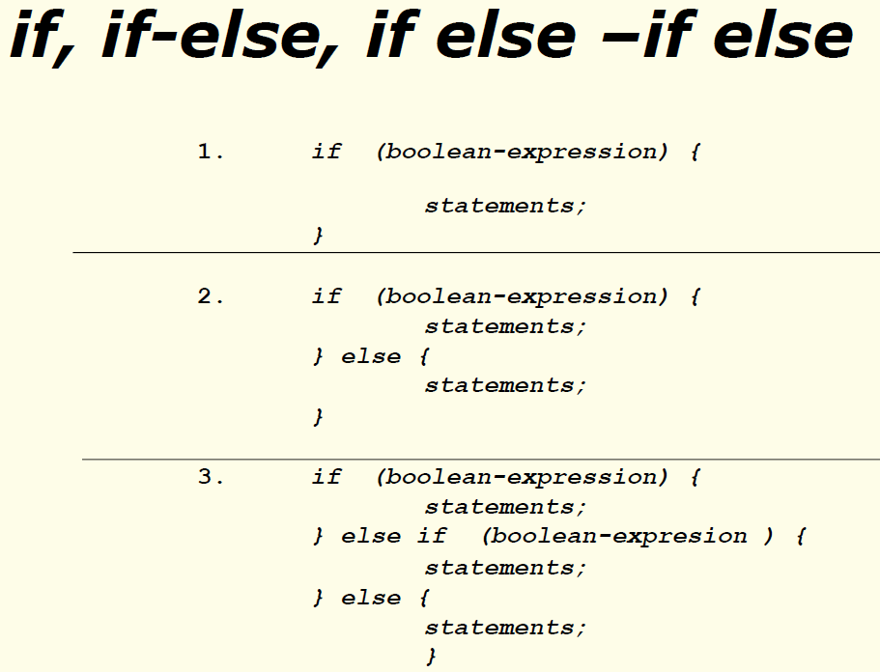
Conditions

Slide 52
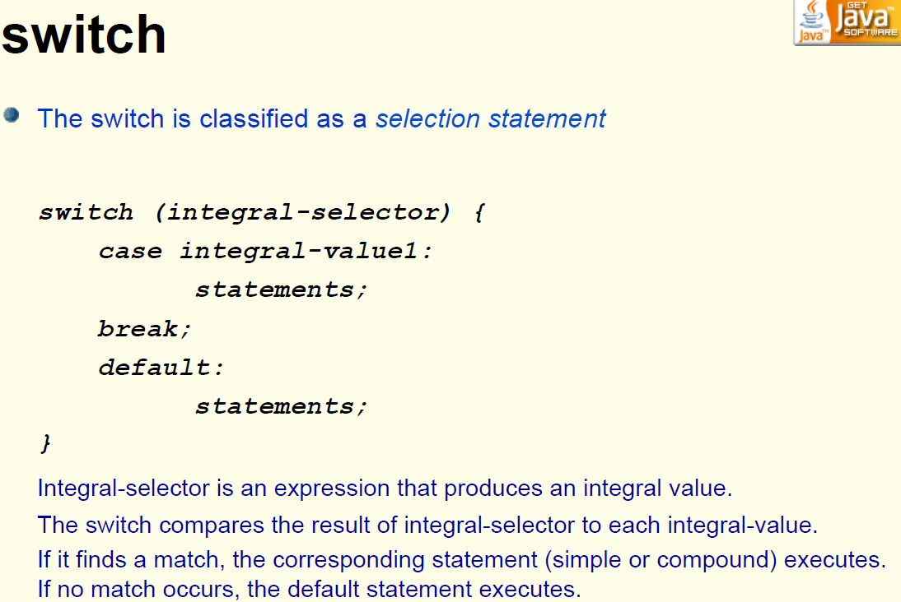
Conditions (Cont’d)

Slide 53
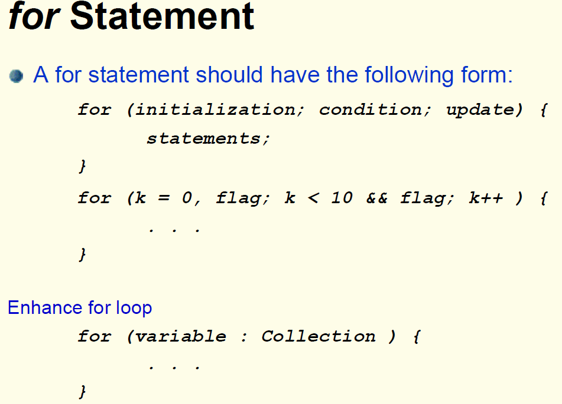
Repetitions

Slide 54
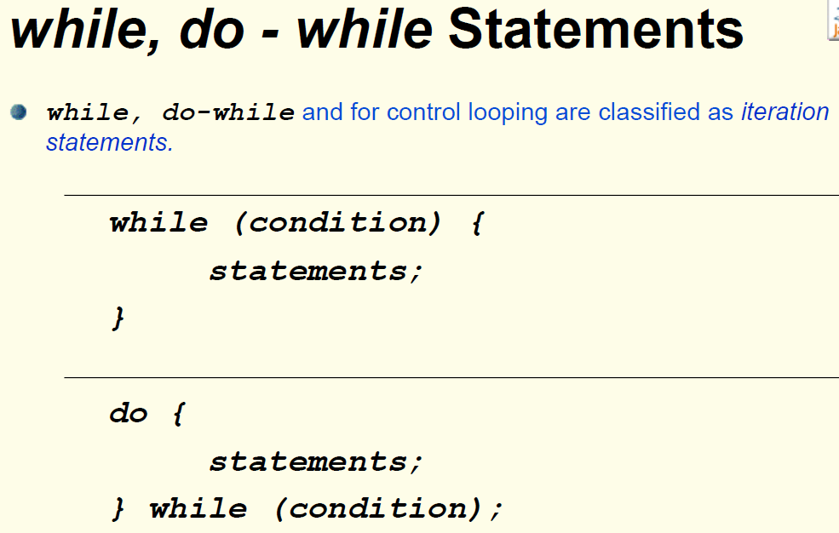
Repetitions (Cont’d)

Slide 55
break - Labeled break
A break “drops out of the bottom” of the loop. The break statement with no label attempts to transfer control to the innermost enclosing switch, for, while or do-while of immediately enclosing statement.
A labeled break drops out of the bottom of the end of the loop denoted by the label.
LabeledBreak.java; trace to see what happens!

Slide 56
continue – Labeled continue
A plain continue goes to the top of the innermost loop and continues.
A labeled continue goes to the label and re-enters the loop right after that label.
LabeledContinue.java; trace to see what happens!

Slide 57
LOOPS
Which expression is NOT an element of a for loop?
Initialization expression
Termination expression
Iteration expression
Increment expression
Notes:
Ans. Iteration expression
for (initialization; termination; increment) {
statement(s)
}
The initialization expression initializes the loop; it's executed once, as the loop begins.
When the termination expression evaluates to false, the loop terminates.
The increment expression is invoked after each iteration through the loop; it is perfectly acceptable for this expression to increment or decrement a value.

Slide 58
Identifiers in Java
The name you choose for anything in java is called a java identifier.
Identifiers must start with a letter, an underscore ( _ ) or a dollar sign ( $ ) followed by letters or digits.
There is no limit for the length of identifiers and they are composed from the Unicode character set.
Ex: toStart _color $accountÉvalué übung μαθαίνω
Java language keywords cannot be used as identifiers.

Slide 59
Literals in Java
Each type in Java has literals, which are the way that constant values of that type are written.
Integer constants are string of octal, decimal, hexadecimal digits. Ex: decimal 58L, octal 027, hexadecimal 0x8AF
Floating-point numbers are decimal numbers optionally followed by an exponent. Ex: double 18. .234E3 or 1.8e-1; float 1.234f or 0.2e-5F
Characters literals appear between single quotes. Any valid Unicode character can appear between the quotes. Certain special characters are represented as escape sequence. Ex: ‘J’, ‘A’, ‘V’, ‘A’, ‘\n’ (newline), ‘\u000A’, ‘\t ‘(tab), ‘\u0009’, \ddd (a char by octal value d: 0-7)
String literals appear between double quote. Ex: “JAVA”

Slide 60
Overview of Classes and Objects in Java
Each class has three kinds of members:
Fields are data variables of a class that store results of computations performed by class’s methods.
Methods contain the executable code, built from statements.
Classes and interfaces can in the same time be members of a class.
Every object in Java has a state and a behavior as in the following example:
class Point {
/* the state of object is defined by values of its data */
private double x_ = 0;
private double y_ = 0;
/* the behaviors of an object is defined by its methods */
public void movePoint(double x, double y) {
x_ = x; y_ = y;
}
}

Slide 61
Overview of recursive methods
In Java a method could call other methods. A method can also call itself. Such a method is called a recursive method.
Let us suppose that we want to calculate factorial of n: Factorial of n is written n! and it is equal to 1 * 2 * ...* n (i.e., the product of all numbers from 1 to n). For example 3! = 1 * 2 * 3 = 6.
One can notice that n! = n * (n-1)! For example 3! = 3 * 2! = 3 * 1 * 2 = 1 * 2 * 3 = 6. Therefore, if we want to calculate factorial of n, we can use iterative (loops) or recursive method.
Factorial.java which is provided to you contains both implementations.

Slide 62
Comments and Named Constants
Comments in Code: enable to write descriptive text.
/* Comment type 1 – This text is ignored by the compiler */
// Comment type 2 – The text up to the end of line is ignored
/** Documentation comment is extracted by javadoc tool */ (The java doc comments are /** ... */ and are use to generate HTML documentation using the javadoc application)
Named Constants: names used to describe constants.
public final int MAX_INDEX = 1000;
OR
class MathConstants {
//the base of the natural logarithms
final double E = 2.71;
final double PI = 3.14;
}

Slide 63
Method overloading
It happens if the number/type/order of two methods in a class differ, even if they have the same names (different method signatures.)
It doesn’t have anything to do with the return type as in:
public class PreT3 {
public int method(int a, int b) {
return a * b;
}
public float method(int x, int y) {
return (float) (x + y);
}
}

Slide 64
Some Other Java Programming Basics
Access modifiers in Java (public, private, protected, and package).
The default access modifier for instance variables or fields in a class is package (if no access modifier is specified).
Default values of the primitive data types “as fields”.
Type wrapper classes.

Slide 65
Lab Activities
1- The Fibonacci sequence is an infinite sequence that starts with terms 1 and 1 and each successive term is the sum of the previous two terms. Develop a simple Java program that prints out the first 40 Fibonaccis. Use 40 as the value of a final int variable.
2- What Happens if you want to print the first 100? Why?

Slide 66
Lab Activities (Cont’d)
3- Develop a simple Java program that prints out bitwise operations (and, or, xor, not)on two sample integers (say 84 and 327)and prints out the results in decimal, binary, octal, and hex.
4- Develop a simple Java program that prints out bitwise shift operations (>>> and >>)on a sample integer (say -1)and prints out the results. Could you see the difference?

Slide 67
Lab Activities (Cont’d)
5- Develop a simple Java program that illustrates how down-casting from a type (say short as an example) to another type (say byte as an example)could result in surprising results. Also, develop a method that takes an integer and prints out its binary equivalent and use that method to show why this happens.

Slide 68
Lab Activities (Cont’d)
6- THE GREATEST COMMON DIVISOR – EUCLID: the greatest common divisor(gcd)of two or more integers, when at least one of them is not zero, is the largest positive integer that divides the numbers without a remainder. For example, the GCD of 24 and 8 is 8.
Pseudocode code: function gcd(a, b) while b ≠ 0 t := b b := a mod b a := t return a
so, in the next iteration "a" becomes "b" and "b" becomes "a mod b“. Develop a simple Java program that calculates the gcd of two integers, recursively.

Slide 69
Lab Activities (Cont’d)
7- A file named Primes.java has been given to you in the files of this week. Implement the methods findPrimesFaster in class Primes by copying the code from the findPrimes method and modifying it to have the following features:
Uses labeled continue instead of break.
Does not require the isPrime variable.
Only tries to divide by integers up to the square root of the number being tested (use Math.sqrt() method which takes a double as the argument, Also System.currentTimeMillis() method gives you the current time in milliseconds).
Do you see the difference in timing and performance?

